Slide 1
Chest Pneumonia Detection
Data Analysis and Machine Learning Using Python Internship
One Man Army
Harshit Gupta

Slide 2
Outline
Problem Statement
Objective
Motivation
Dataset Description
Data Visualisation
Preparing the Data to feed into the Model

Slide 3
Problem Statement
The risk of pneumonia is immense for many, especially in developing nations where billions face energy poverty and rely on polluting forms of energy.
4 million premature deaths occur annually [1].
Over 150 million people get infected with pneumonia every year[2].
Accurate and fast diagnosis can guarantee timely access to treatment and save time and money
[1] World Health Organization, Household Air Pollution and Health [Fact Sheet], WHO, Geneva, Switzerland, 2018,
http://www.who.int/newa-room/fact-sheets/detail/household-air-pollution-and-health.
[2] I. Rudan, L. Tomaskovic, C. Boschi-Pinto, and H. Campbell, “Global estimate of the incidence of
clinical pneumonia among children under five years of age,” Bulletin of the World Health Organization, vol. 82, pp. 85–903, 2004.

Slide 4
Objective
To develop a model which can detect the images and determine if a person is suffering from pneumonia.
To achieve high accuracy in the results
To make the model time and money efficient

Slide 5
Motivation
The world is fighting a hard battle against the Covid-19 pandemic. Studies show that the health conditions of patients are very much similar to Pneumonia.
One of the prime reasons as to why Corona Virus hit the world so hard is because the tests are time taking and it is difficult to detect.
This motivated me to work on this project to contribute towards speeding up the testing and to make it more efficient.

Slide 6
Dataset Description
5856 X-Ray Images
Train
Test
Validation
Pneumonia
Normal
Normal
Pneumonia
Normal
Pneumonia
234
390
1341
3875
8
8
J. Melendez, G. B. Van, P. Maduskar et al., “A novel multiple-instance learning-based approach to computer-aided detection of tuberculosis on chest x-ray,” IEEE Transactions on Medical Imaging, vol. 34, no. 1, pp. 179–192, 2015.

Slide 7
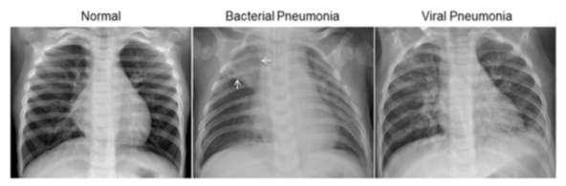

Slide 8
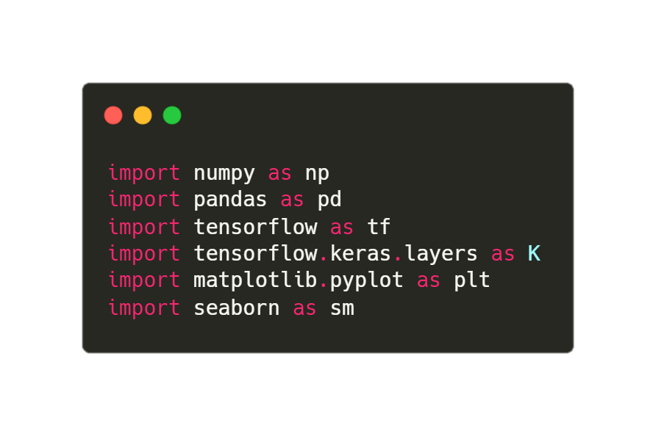
Libraries

Slide 9
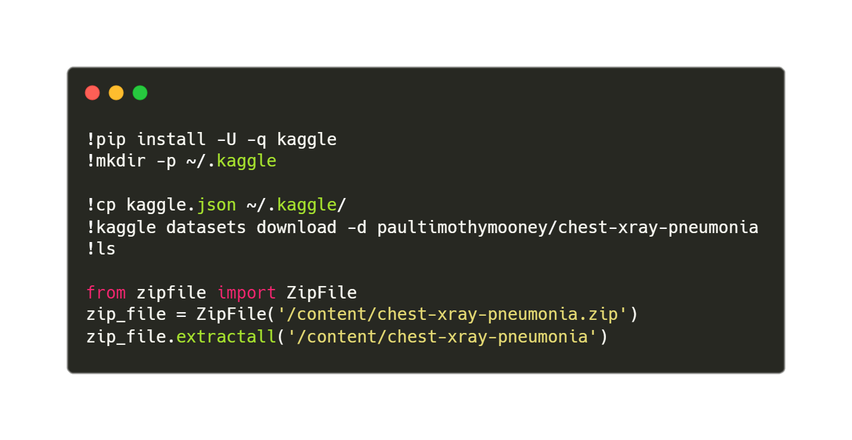
Fetching The Dataset

Slide 10
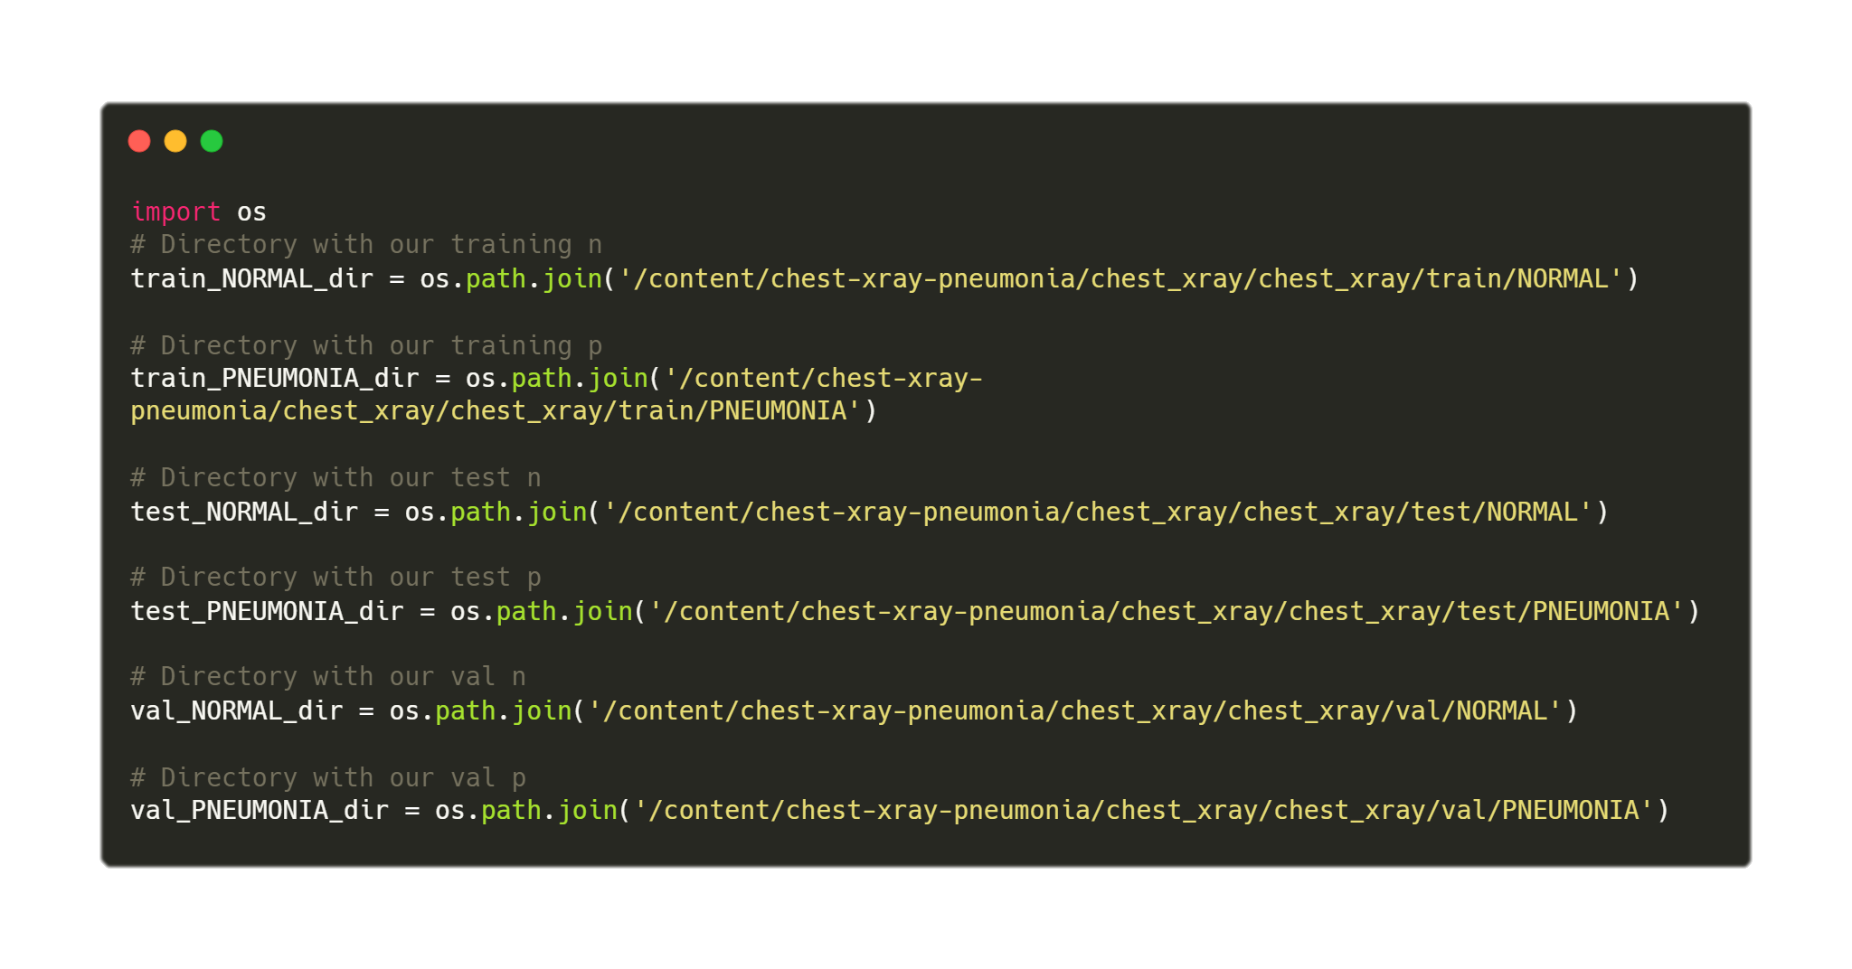
Setting up the variables

Slide 11
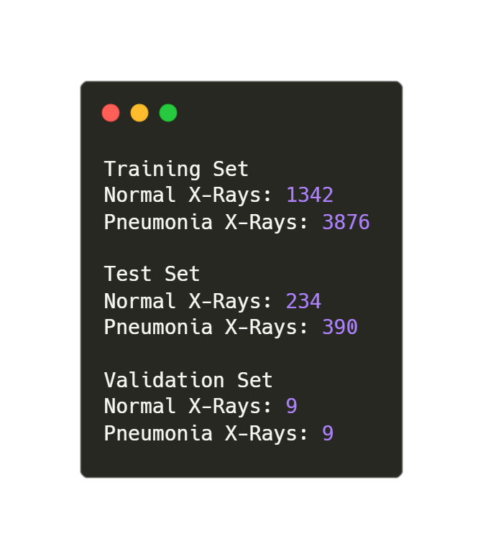
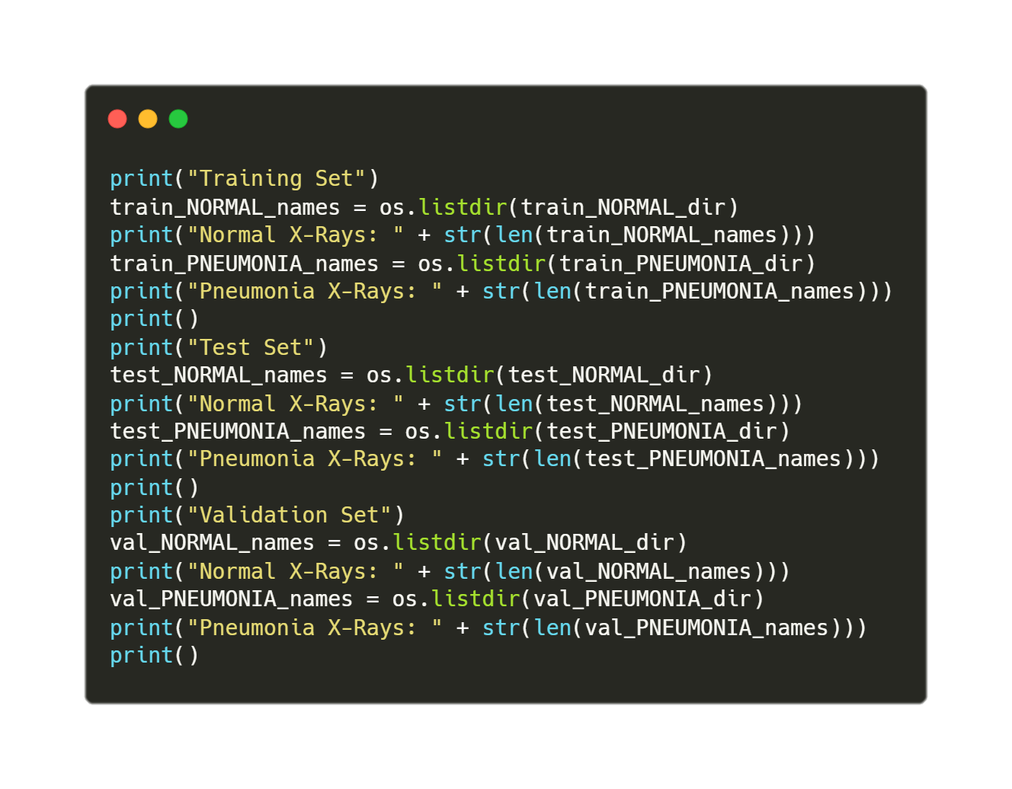
Number of clean images
Source Code
Output

Slide 12
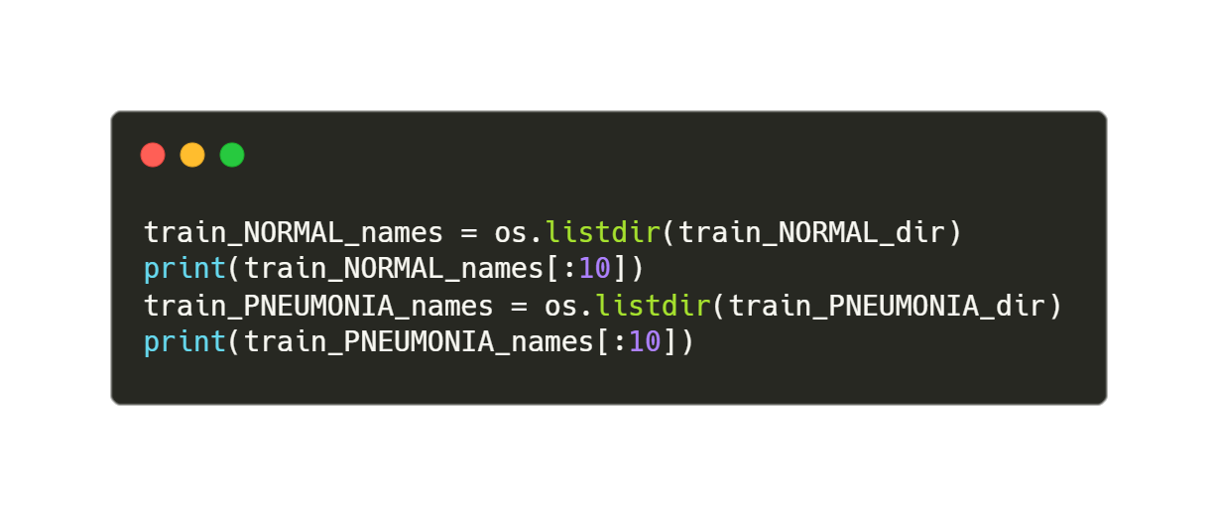
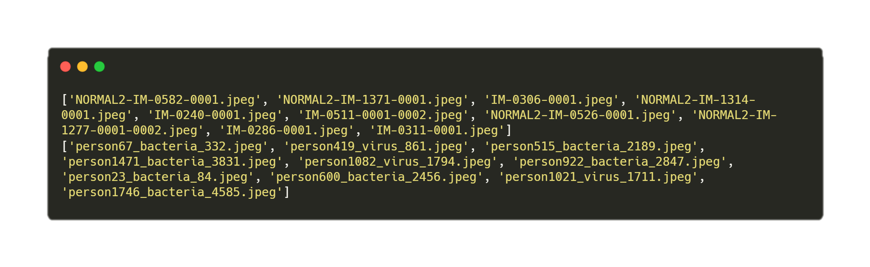
Image Name Samples
Source Code
Output

Slide 13
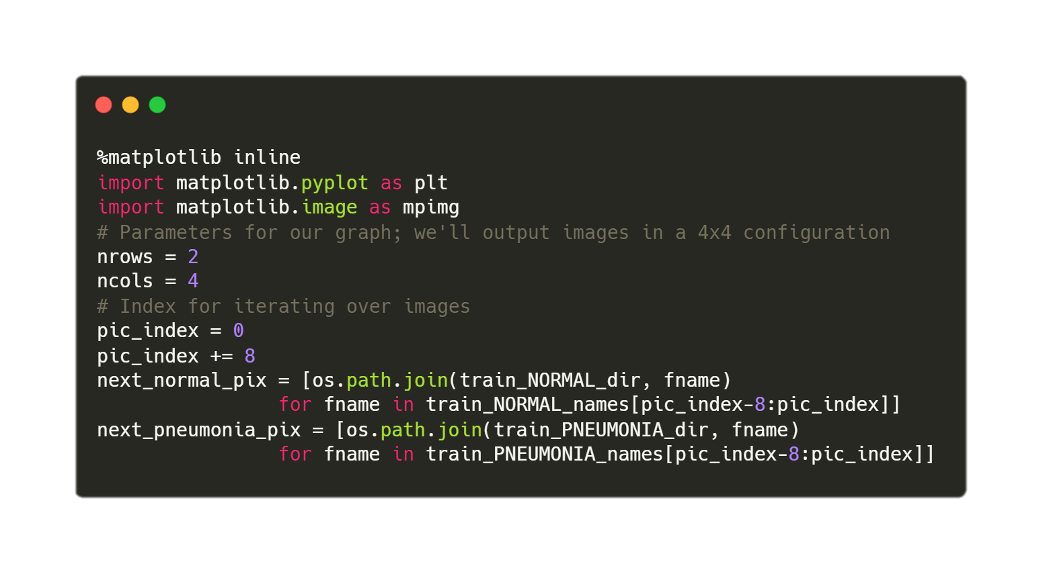
Image Samples – Setting up the plot

Slide 14
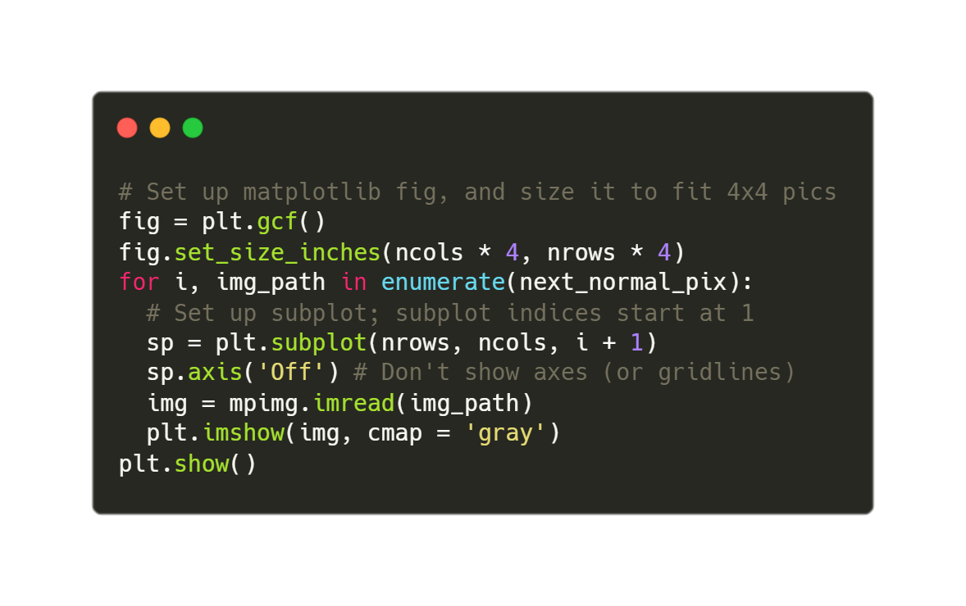
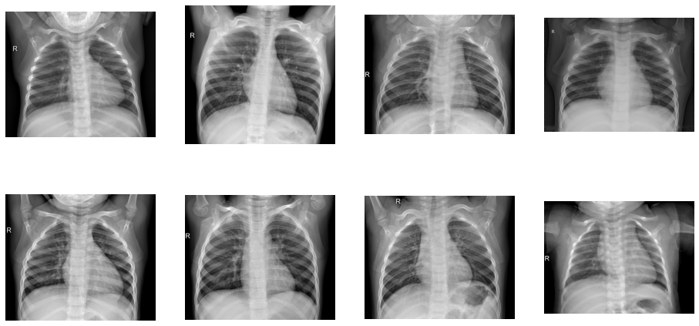
Normal X-Ray Samples
Source Code
Output

Slide 15
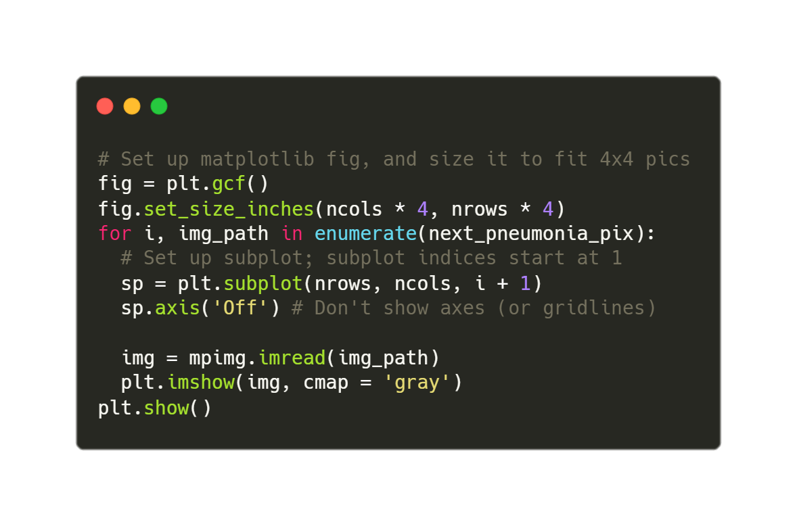
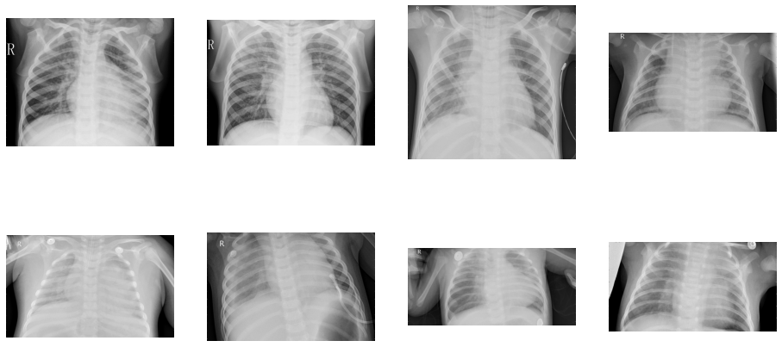
Pneumonia X-Ray Samples
Source Code
Output

Slide 16
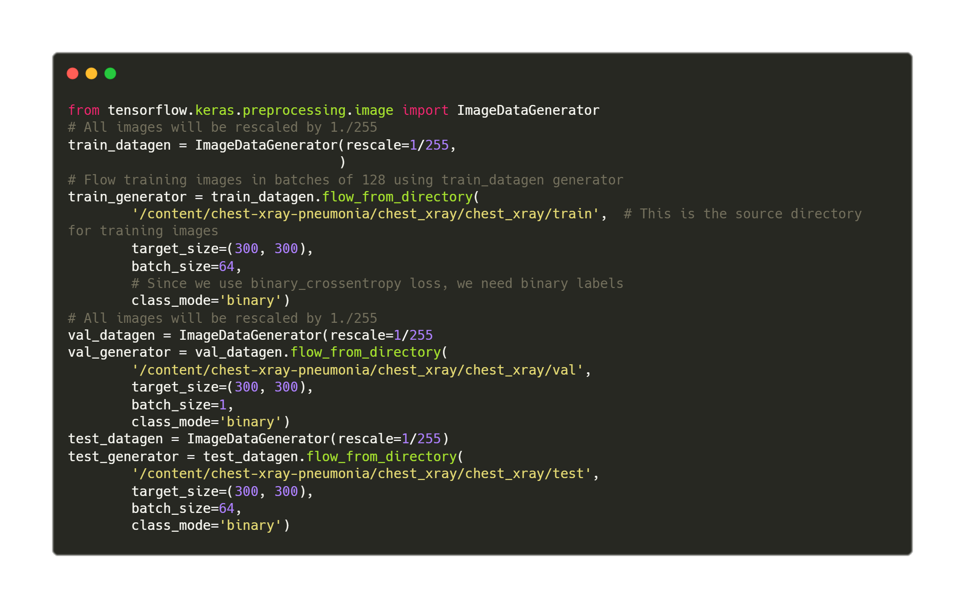
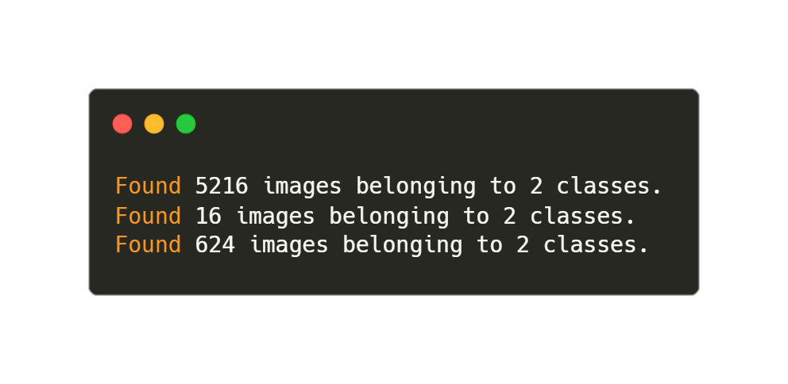
Preparing Generator To Feed Model
Source Code
Output

Slide 17
Data Augmentation
Method | Setting
Resize | 224X224
Rescale | 1/255
Shear Range | 0.2
Zoom Range | 0.2
Horizontal Flip | True

Slide 18
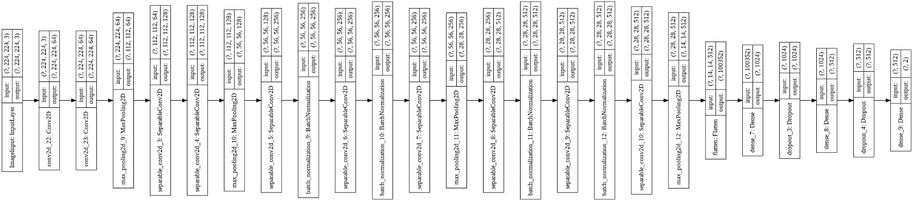
The Model - 25 Layers

Slide 19
The Model - Parameters
Parameter Type | Number
Non-trainable Parameters | 3,072
Trainable Parameters | 104,194,434
Total Parameters | 104,197,506

Slide 20
Training
Parameter | Value
Batch Size | 14
Epochs | 50
Early Stopping
Learning Rate Reduction
Loss | Binary Cross Entropy
Metrics | Accuracry
Learning Rate | 0.0001
Optimizer | Adam
Steps per epoch | 500
Validation Steps per epoch | 10

Slide 21
Training – Early Stopping
To stop the model if no progress is made
Monitored on Validation Loss
Patience of 25 Epochs

Slide 22
Training – Reduction of Learning Rate
To reduce the learning rate while training
Monitored on Validation Loss
Factor of 0.8
Patience of 5 epochs
Minimum delta of 0.0001
Minimum learning rate of 0.0001

Slide 23
Done!
550s approximately for each epoch
50 epochs
8 hrs! Phewwww!
Best Model found after epoch 33

Slide 24
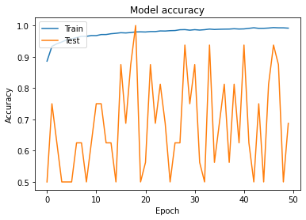
The Results – Model Accuracy

Slide 25
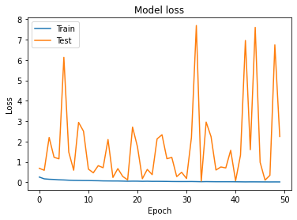
The Results – Model Loss

Slide 26
The Results – Val and Train Set
Parameter | Value
Training Loss | 0.0300
Training Accuracy | 98.86%
Validation Loss | 0.0571
Validation Accuracy | 93.75%

Slide 27
The Results – Test Set
Parameter | Value
Test Loss | 2.3062775135040283
Test Accuracy | 80.28846383094788%

Slide 28
So What Do We Have Now?
A model with validation accuracy of 93.75% and test accuracy of 80.28%

Slide 29
Thank You
Harshit Gupta

